Slide 1
Lesson objective
Whiteboards and calculators.
Title: Comparing best buys
Aim:
Attain a price per 100g for best buy items.
Determine a price per kilo from random weight increments
Plan:
Review substitution
100g review
Comparing random weights

Slide 2
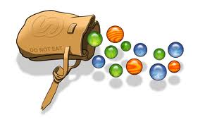







SAMPLE Probability Questions:
A bag contains 7 blue, 5 purple, 12 red, and 6 orange marbles. Find each probability if you draw one marble at random from the bag. Write as a fraction in simplest form.
a) P(purple) b) P(red or orange) c) P(not blue)
You roll a standard number cube (six sides numbered 1 – 6). After one roll, answer the following:
a) P(3 or 4) b) P(even #) c) P(not 2)
$\frac{5 }{30 }$ or $\frac{1}{6}$
$\frac{18 }{30 }$ or $\frac{3}{5}$
$$\frac{23 }{30 }$$
$\frac{2 }{6 }$ or $\frac{1}{3}$
$\frac{3 }{6 }$ or $\frac{1}{2}$
$$\frac{5 }{6 }$$
Notes:
Try answering these before veiwing the answers

Slide 3



Sample “Experimental” Probability Questions:
Mike was practicing basketball shots. Out of 24 attempts, he made 21 baskets. Based on this rate, what is the probability that Mike’s next shot will go in the basket?
Jane was throwing darts. Out of 12 attempts, 3 were bulls-eyes. If Jane were to make 36 attempts, how many should be bulls-eyes?
$\frac{21}{24 }$ or $\frac{7}{8}$
9

Slide 4

Daily review
What sample space of this spinner?
What is the probability of green?
After 100 spins, how many would you expect
to be green?
Red and yellow are ________ likely.

Slide 5
Substitution
Whiteboards
If a = 5, e = 2 and h = 9, evaluate the following expressions:
a + e + h =
6e – 2a =
2h + 3e =

Slide 6
Best Buys
Finding the price per kilo if the weight is in multiples of 100g.
Steps
Divide to get 100g cost
Times by 10 to get $ per kilo

Slide 7
The power of examples
Having an example next to your notes is surprisingly helpful…and not enough students actually write examples…
e.g. Horse cubes are $9 per 400g
What can I divide 400 by to get 100?
Divide to get 100g cost
Times by 10 to get $ per kilo

Slide 8
The power of examples
Having an example next to your notes is surprisingly helpful…and not enough students actually write examples…
e.g. hair gel is $11 per 300g
What can I divide 300 by to get 100?
Divide to get 100g cost
Times by 10 to get $ per kilo

Slide 9
The power of examples
Having an example next to your notes is surprisingly helpful…and not enough students actually write examples…
e.g. cheese is $15 per 700g
What can I divide 700 by to get 100?
Divide to get 100g cost
Times by 10 to get $ per kilo

Slide 10
The power of examples
Having an example next to your notes is surprisingly helpful…and not enough students actually write examples…
e.g. fish food is $20 per 900g
What can I divide 900 by to get 100?
Divide to get 100g cost
Times by 10 to get $ per kilo

Slide 11
Whiteboards
Divide to get 100g cost
Times by 10 to get $ per kilo
Sally paid $11.50 for 400g of ham. How much was it for
100g
1kg

Slide 12
Whiteboards
Divide to get 100g cost
Times by 10 to get $ per kilo
A jar of Nutella costs $6.90 for 300g. How much is it per:
100g
1kg

Slide 13
Whiteboards
Divide to get 100g cost
Times by 10 to get $ per kilo
Beans cost $9.25 for 500g. How much are they for:
100g
1kg

Slide 14
Whiteboards
Divide to get 100g cost
Times by 10 to get $ per kilo
Which is better value? Compare 100g prices
Mr. Davies favourite chocolate
Some other chocolate
$8 for 200g.
$18 for 500g

Slide 15
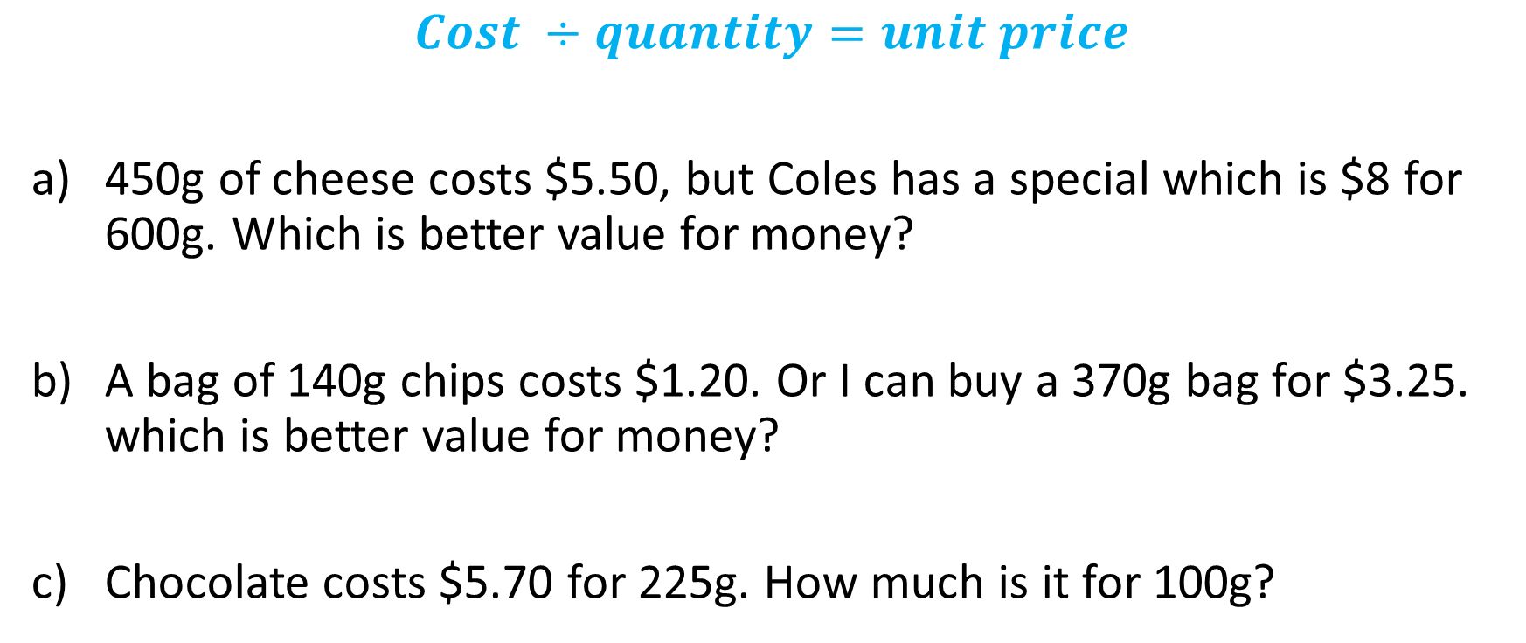
Comparing price: unitary method
$$Cost ÷quantity=unit price$$
450g of cheese costs $5.50, but Coles has a special which is $8 for 600g. Which is better value for money?
A bag of 140g chips costs $1.20. Or I can buy a 370g bag for $3.25. which is better value for money?
Chocolate costs $5.70 for 225g. How much is it for 100g?

Slide 16
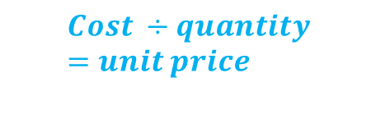
We do
$$Cost ÷quantity=unit price$$
410g of bait costs $11.40. 1kg of bait costs $25.50. which is better value?
The movies sell Maltesers at $9.20 for 425g. Woolies sells a 600g bag for $12.50 – which is better value for money?
Vegemite costs $6.70 for 325g. How much is it for 100g?

Slide 17
Comparing best buys task sheet

Slide 18
Fist to five
Aim:
Attain a price per 100g for best buy items.
Determine a price per kilo from random weight increments

